Slide 1





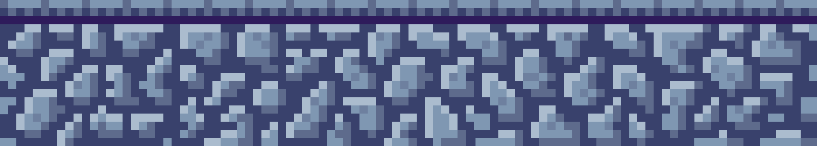
AI Gamebot
Reinforcement Learning Model

Slide 2


TABLE OF CONTENTS
Introduction
Reinforcement Learning
How does it work
Environment Setup
Model Training

Slide 3

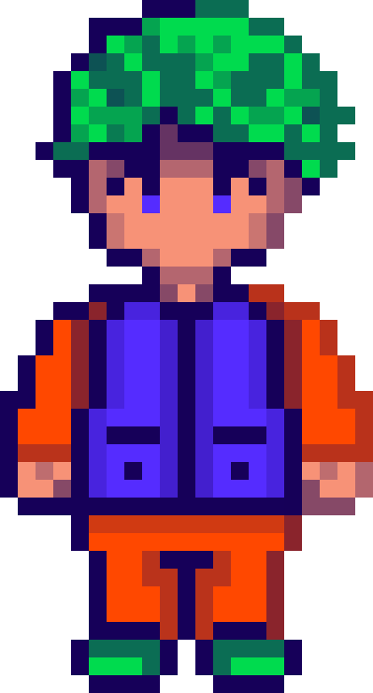
INTRODUCTION
Notes:
Reinforcement Learning (RL) is a branch of machine learning focused on making decisions to maximize cumulative rewards in a given situation. Unlike supervised learning, which relies on a training dataset with predefined answers, RL involves learning through experience. In RL, an agent learns to achieve a goal in an uncertain, potentially complex environment by performing actions and receiving feedback through rewards or penalties.

Slide 4
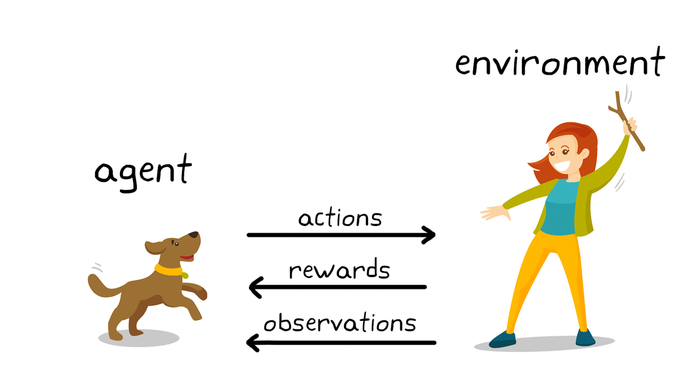
CONCEPT
Elaborate on what you want to discuss.
Notes:
One thing to keep in mind is that reinforcement learning is not sample efficient. That is, it requires a large number of interactions between the agent and the environment to collect data for training. As an example, AlphaGo, the first computer program to defeat a world champion at the game of Go, was trained non-stop for a period of a few days by playing millions of games, accumulating thousands of years of human knowledge.

Slide 5
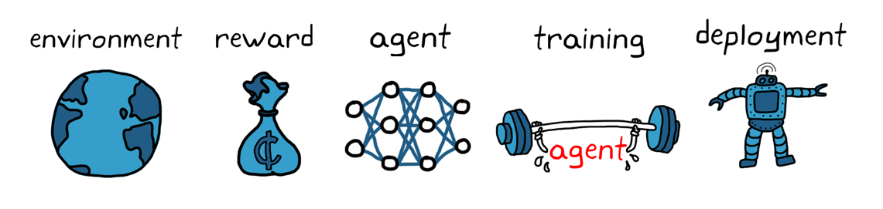

WorkFlow
Notes:
Agent: The learner or decision-maker.
Environment: Everything the agent interacts with.
State: A specific situation in which the agent finds itself.
Action: All possible moves the agent can make.
Reward: Feedback from the environment based on the action taken.

Slide 6
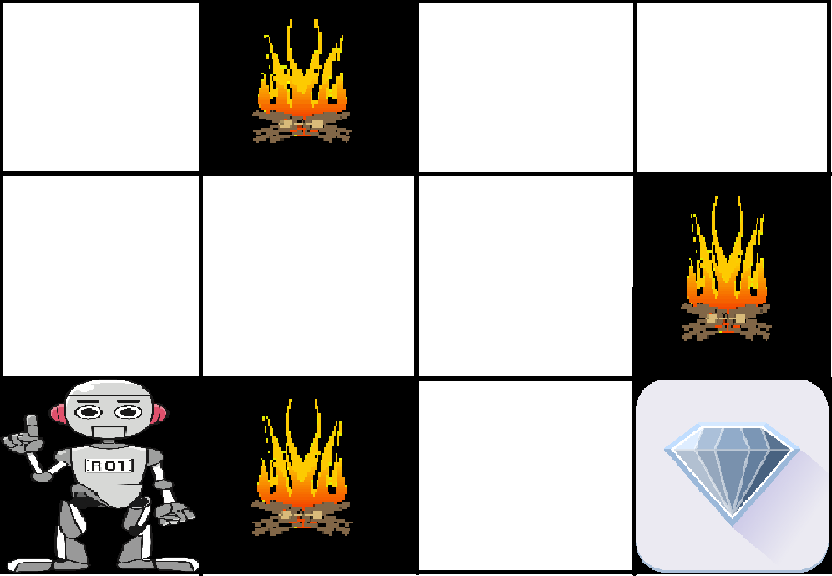
Example
Notes:
The goal of the robot is to get the reward that is the diamond and avoid the hurdles that are fired. The robot learns by trying all the possible paths and then choosing the path which gives him the reward with the least hurdles. Each right step will give the robot a reward and each wrong step will subtract the reward of the robot. The total reward will be calculated when it reaches the final reward that is the diamond.

Slide 7
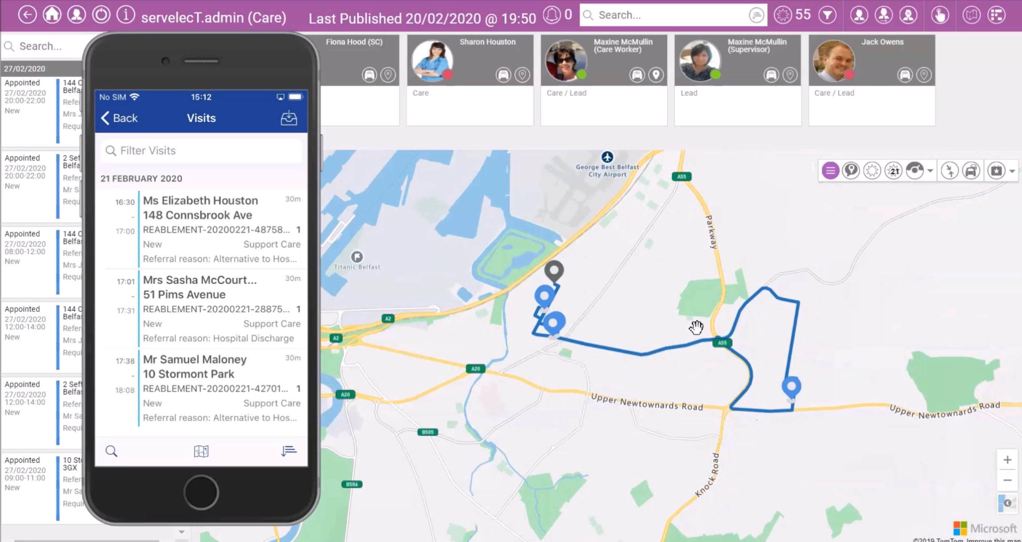
Objective Function

Slide 8
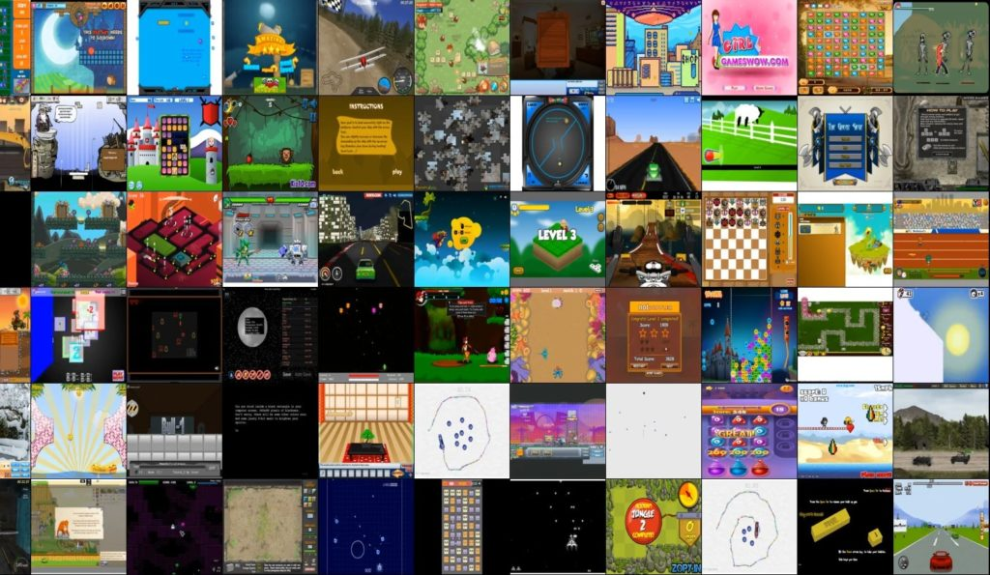
Environment Setup
OpenAI Gym Retro
Wrapper
Virtual Environment
TensorBoard
Notes:
It sets up an environment for reinforcement learning and comes with integrations for ~1000 games.
It uses various emulators that support the Libretro API.

Slide 9
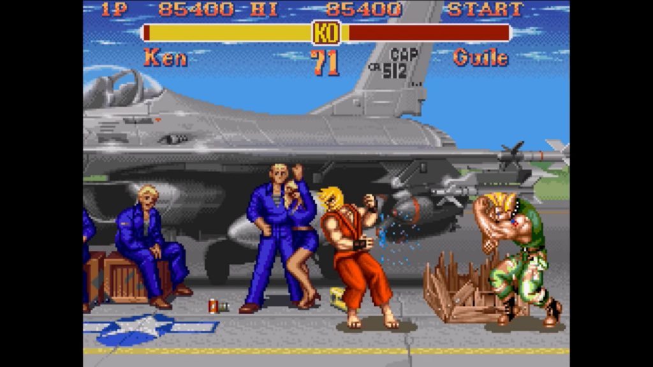
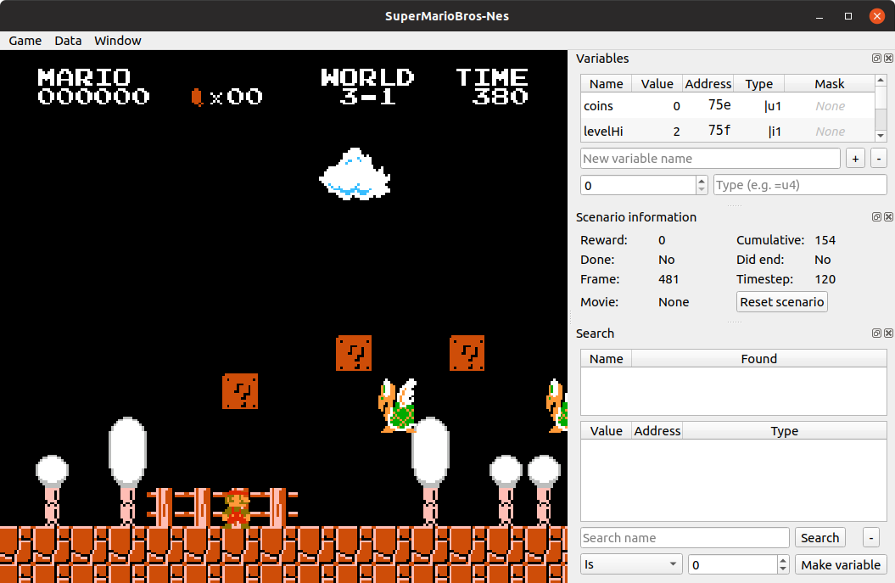
Game Learning Model

Slide 10



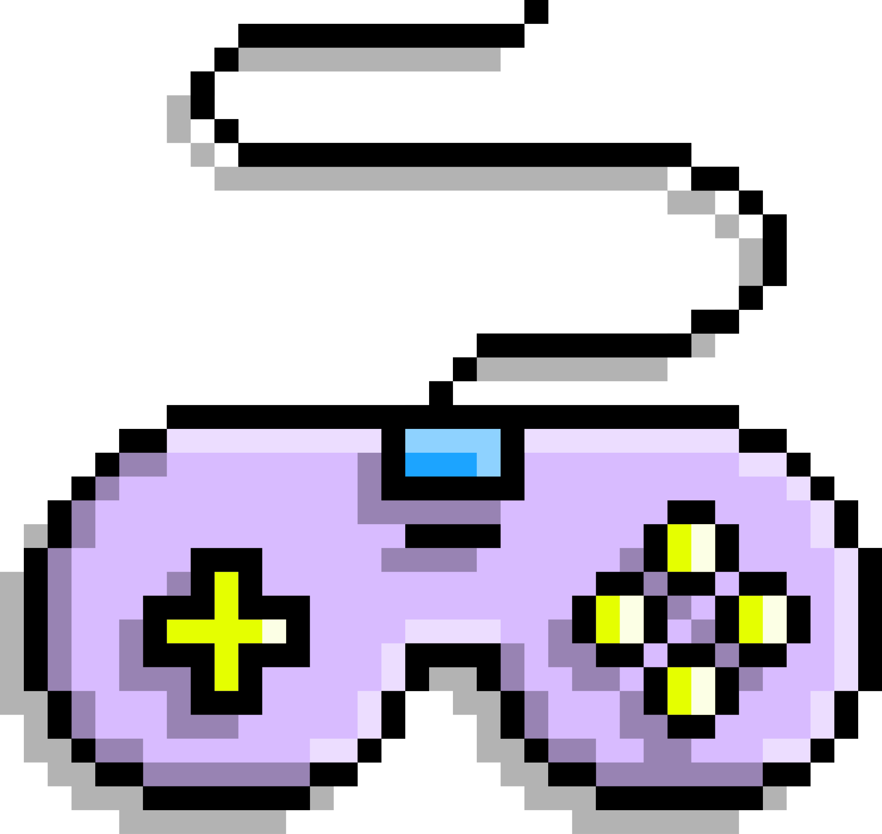
Reward Function
Lost
Fighting
Win
Get the Negative Reward
Get the HP Delta
Get the Positive Reward

Slide 11

Why M.Bison
Difficult
Cheating
Challenge

Slide 12
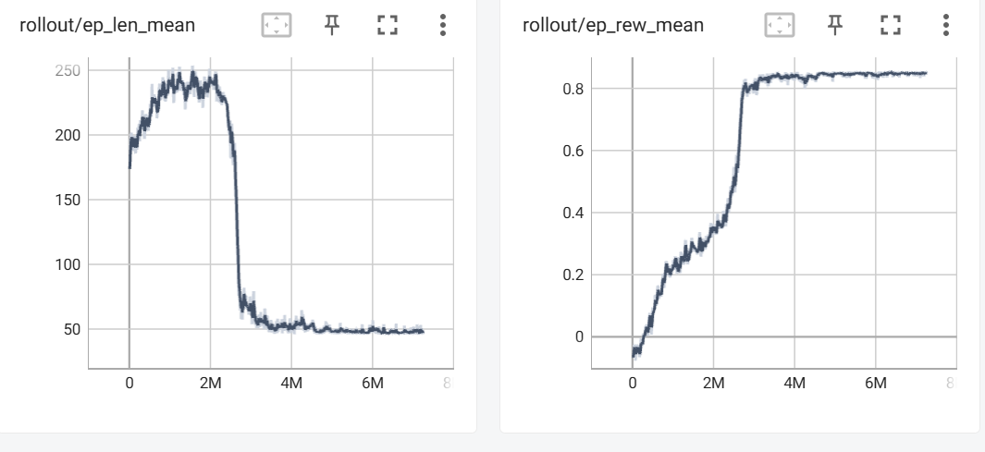
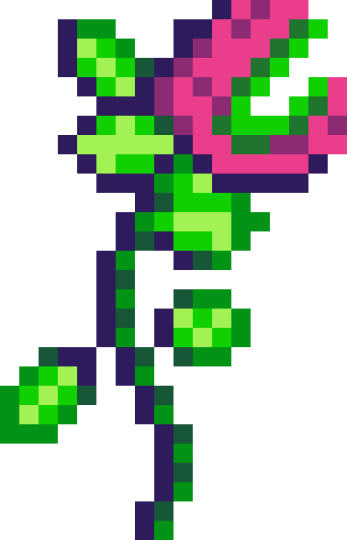
Model Training
1M
2M
2.5M
3M
7M

Slide 13

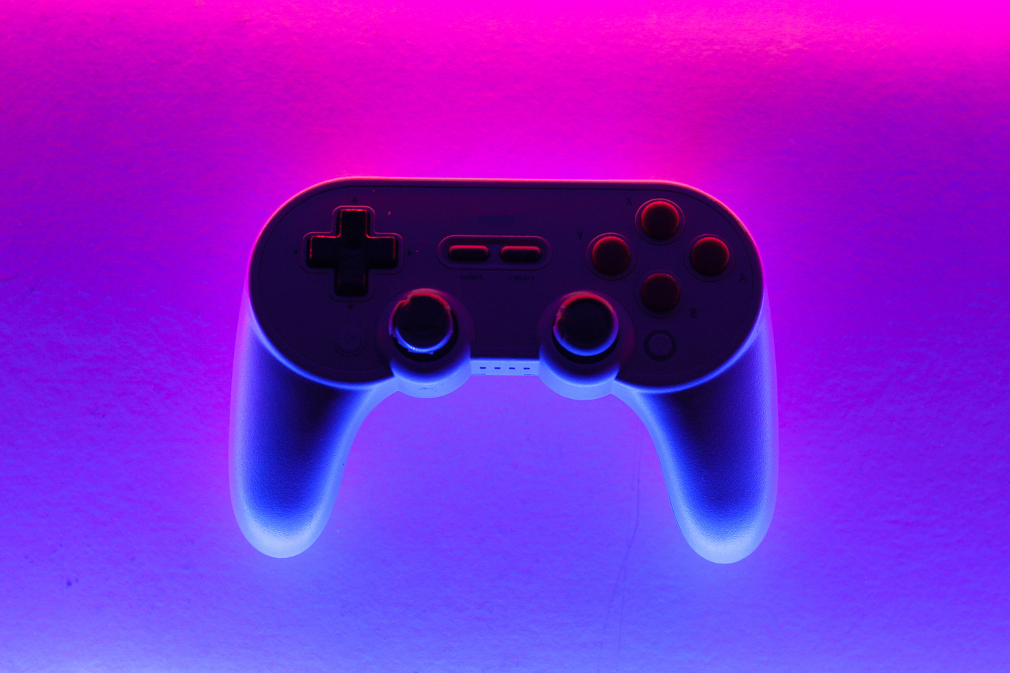
Let’s Fight

Slide 14
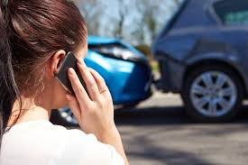
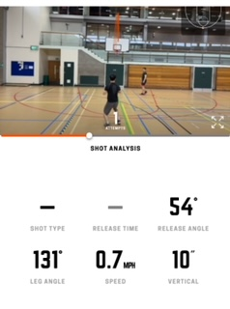
Application
Insurance Investment
Sport Simulation Model
Auto Driving

Slide 15


Reference
  DIAMBRA Arena: a New Reinforcement Learning Platform for Research and Experimentation
  Mitigating Cowardice for Reinforcement Learning
  paper_111.pdf

Slide 16

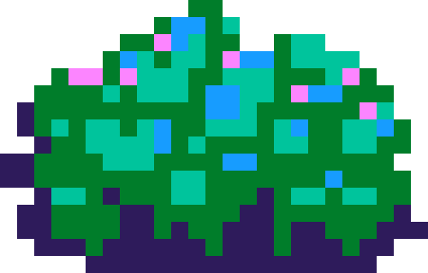
THANK YOU!

